Slide 1
Basketball’s hot hand theory analysis
With statistics from NBA Playoff 2018-2019

Slide 2
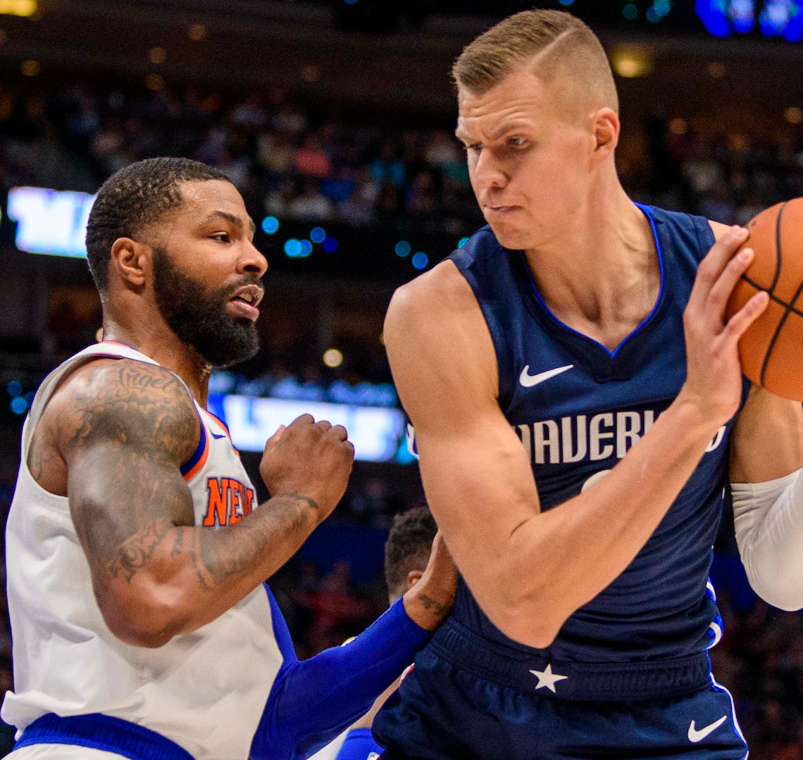
NOTE:
To change images on this slide, select a picture and delete it. Then click the Insert Picture icon
in the placeholder to insert your own image.
Statistik merupakan salah satu bagian penting dari olahraga bola basket. Pada olahraga ini, statistik sering kali dijadikan materi penting bagi pelatih untuk menentukan strategi yang akan digunakan saat pertandingan.
Salah satu interpretasi data dari statistik tersebut menghasilkan sebuah teori yang sering diperdebatkan hingga saat ini, yaitu hot hand theory

Slide 3
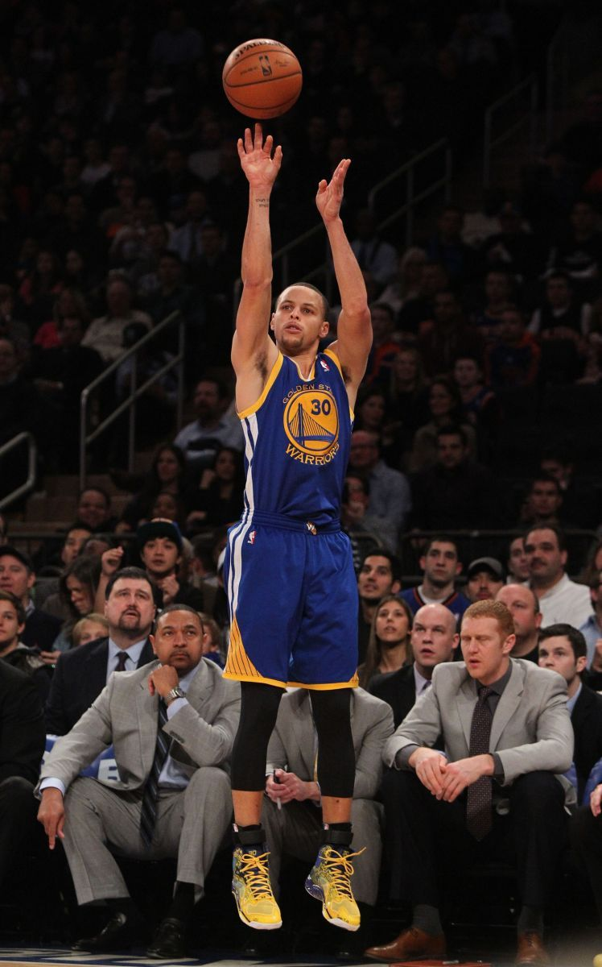
Apa itu hot hand theory?
Gilovich et al. (1985) menyatakan bahwa hot hand adalah teori yang dipercaya oleh banyak fans dan pemain basket bahwa seorang pemain memiliki kemungkinan untuk memasukkan sebuah tembakan lebih besar saat tembakan sebelumnya sukses, dibandingkan saat tembakan sebelumnya gagal.

Slide 4

Metode analisis
Data diambil dari website NBA
Pemain yang diambil merupakan pemain dari 2 tim yang bermain hingga babak final playoff 2018-2019 (Golden State Warriors & Toronto Raptors) dengan rataan waktu bermain > 24 menit (separuh pertandingan)
Berdasarkan filter diatas didapatkan 10 pemain, dimana 4 diantaranya merupakan pemain Golden State Warriors dan 6 pemain merupakan pemain Toronto Raptors
Data mengenai berhasil/tidaknya tembakan pemain yang lolos filter tersebut akan dilihat rangkaiannya, dan dibagi menjadi 4, yaitu:
Missed Shot - Made Shot
Missed Shot - Missed Shot
Made Shot - Made Shot
Made Shot – Missed Shot

Slide 5

Ekspektasi
Apabila hot hand theory benar adanya, maka :
Jumlah Made Shot - Made Shot > Made Shot – Missed Shot

Slide 6
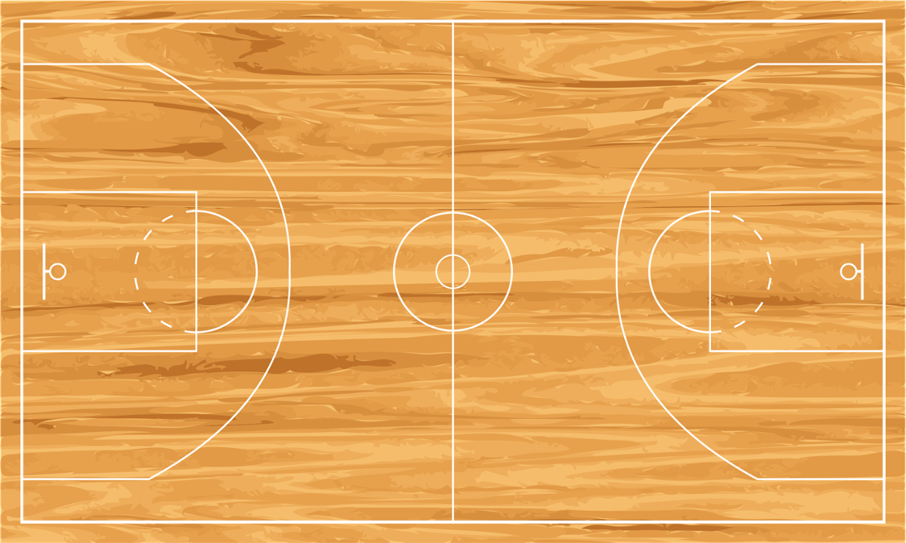
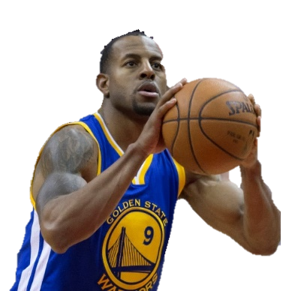
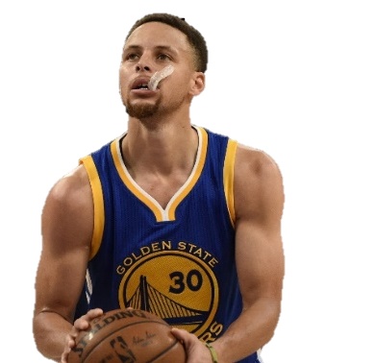
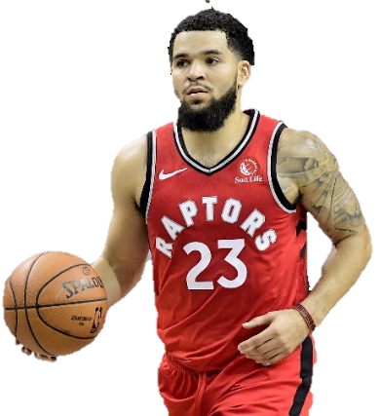
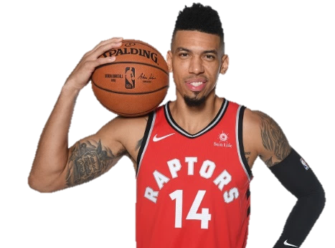
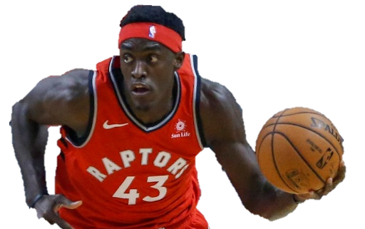
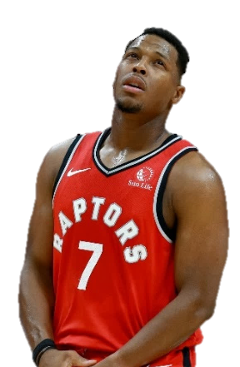
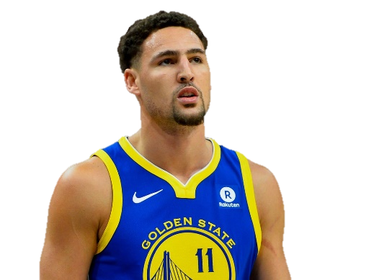
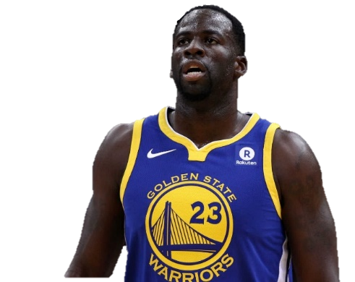
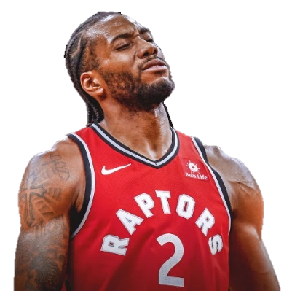
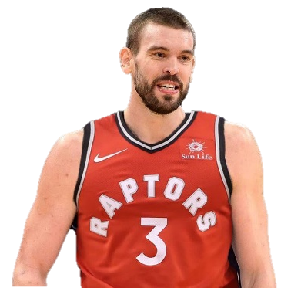
Pemain yang di analisis
Andre Iguodala
Stephen Curry
Fred VanVleet
Danny Green
Pascal Siakam
Klay Thompson
Draymond Green
Kawhi Leonard
Kyle Lowry
Marc Gasol

Slide 7
Field Goal Percentage & Sequence

Slide 8


Andre Iguodala
Stephen Curry

Slide 9
Andre Iguodala
Stephen Curry
Sequence | Amount
Made Shot – Made Shot | 39
Made Shot – Missed Shot | 45
Missed Shot – Missed Shot | 44
Missed Shot – Made Shot | 47
Sequence | Amount
Made Shot – Made Shot | 88
Made Shot – Missed Shot | 105
Missed Shot – Missed Shot | 141
Missed Shot – Made Shot | 106

Slide 10
Klay Thompson
Draymond Green

Slide 11
Klay Thompson
Draymond Green
Sequence | Amount
Made Shot – Made Shot | 78
Made Shot – Missed Shot | 88
Missed Shot – Missed Shot | 113
Missed Shot – Made Shot | 90
Sequence | Amount
Made Shot – Made Shot | 54
Made Shot – Missed Shot | 62
Missed Shot – Missed Shot | 59
Missed Shot – Made Shot | 63

Slide 12
Fred VanVleet
Danny Green

Slide 13
Fred VanVleet
Danny Green
Sequence | Amount
Made Shot – Made Shot | 21
Made Shot – Missed Shot | 47
Missed Shot – Missed Shot | 60
Missed Shot – Made Shot | 47
Sequence | Amount
Made Shot – Made Shot | 18
Made Shot – Missed Shot | 38
Missed Shot – Missed Shot | 69
Missed Shot – Made Shot | 39

Slide 14
Kawhi Leonard
Pascal Siakam

Slide 15
Kawhi Leonard
Pascal Siakam
Sequence | Amount
Made Shot – Made Shot | 114
Made Shot – Missed Shot | 132
Missed Shot – Missed Shot | 127
Missed Shot – Made Shot | 132
Sequence | Amount
Made Shot – Made Shot | 78
Made Shot – Missed Shot | 104
Missed Shot – Missed Shot | 105
Missed Shot – Made Shot | 105

Slide 16
Kyle Lowry
Marc Gasol

Slide 17
Kyle Lowry
Marc Gasol
Sequence | Amount
Made Shot – Made Shot | 50
Made Shot – Missed Shot | 74
Missed Shot – Missed Shot | 86
Missed Shot – Made Shot | 76
Sequence | Amount
Made Shot – Made Shot | 31
Made Shot – Missed Shot | 48
Missed Shot – Missed Shot | 61
Missed Shot – Made Shot | 49

Slide 18
Analisis data

Slide 19
Pemain | Made Shot – Made Shot > Made Shot – Missed Shot
Andre Iguodala | ✗
Stephen Curry | ✗
Klay Thompson | ✗
Draymond Green | ✗
Fred VanVleet | ✗
Danny Green | ✗
Kawhi Leonard | ✗
Pascal Siakam | ✗
Kyle Lowry | ✗
Marc Gasol | ✗
Analisis

Slide 20
Pemain | Missed Shot – Missed Shot > Missed Shot – Made Shot
Andre Iguodala | ✗
Stephen Curry | ✓
Klay Thompson | ✓
Draymond Green | ✗
Fred VanVleet | ✓
Danny Green | ✓
Kawhi Leonard | ✗
Pascal Siakam | =
Kyle Lowry | ✓
Marc Gasol | ✓
Analisis

Slide 21
Analisis
Dari tabel dapat dilihat bahwa tidak ada satupun statistik pemain yang membuktikan kebenaran hot hand theory
Dari 10 pemain yang di analisis, semuanya memiliki rangkaian made shot – made shot yang lebih rendah dari made shot – missed shot
Namun, ada sebuah fakta menarik dimana 60% dari pemain yang di analisis memiliki rangkaian missed shot – missed shot yang lebih tinggi dari missed shot – made shot
Hal ini justru merupakan antithesis dari hot hand theory

Slide 22
Kesimpulan
Berdasarkan analisis dapat disimpulkan bahwa hot hand theory dalam basket tidak dapat dibuktikan. Tidak ada satupun pemain yang di analisis bahkan dapat memiliki tembakan masuk beruntun (made shot – made shot) lebih banyak (atau bahkan sama banyak) dari tembakan masuk berseling (made shot – missed shot)
Lebih dari separuh sampel memiliki persentase tembakan gagal beruntun (missed shot – missed shot) lebih banyak dibandingkan tembakan gagal berseling (missed shot – made shot).
Hal ini dapat memunculkan teori baru yang merupakan kebalikan dari hot hand theory, yaitu cold hand theory.

Slide 23
Link
Statistik diambil dari:
https://stats.nba.com/players/traditional/?sort=MIN&dir=-1&Season=2018-19&SeasonType=Playoffs&CF=MIN*GE*24&PORound=4
Github Repository:
https://github.com/AFSiraj/UAS-Probstok
Source code (Google Colab):
https://colab.research.google.com/drive/1WT3cC-IMZc9KOJI0ogLfMY4tmUsXKtzQ
Post media social (Instagram):
https://www.instagram.com/p/B6I7O_slnOr/

